Slide 1
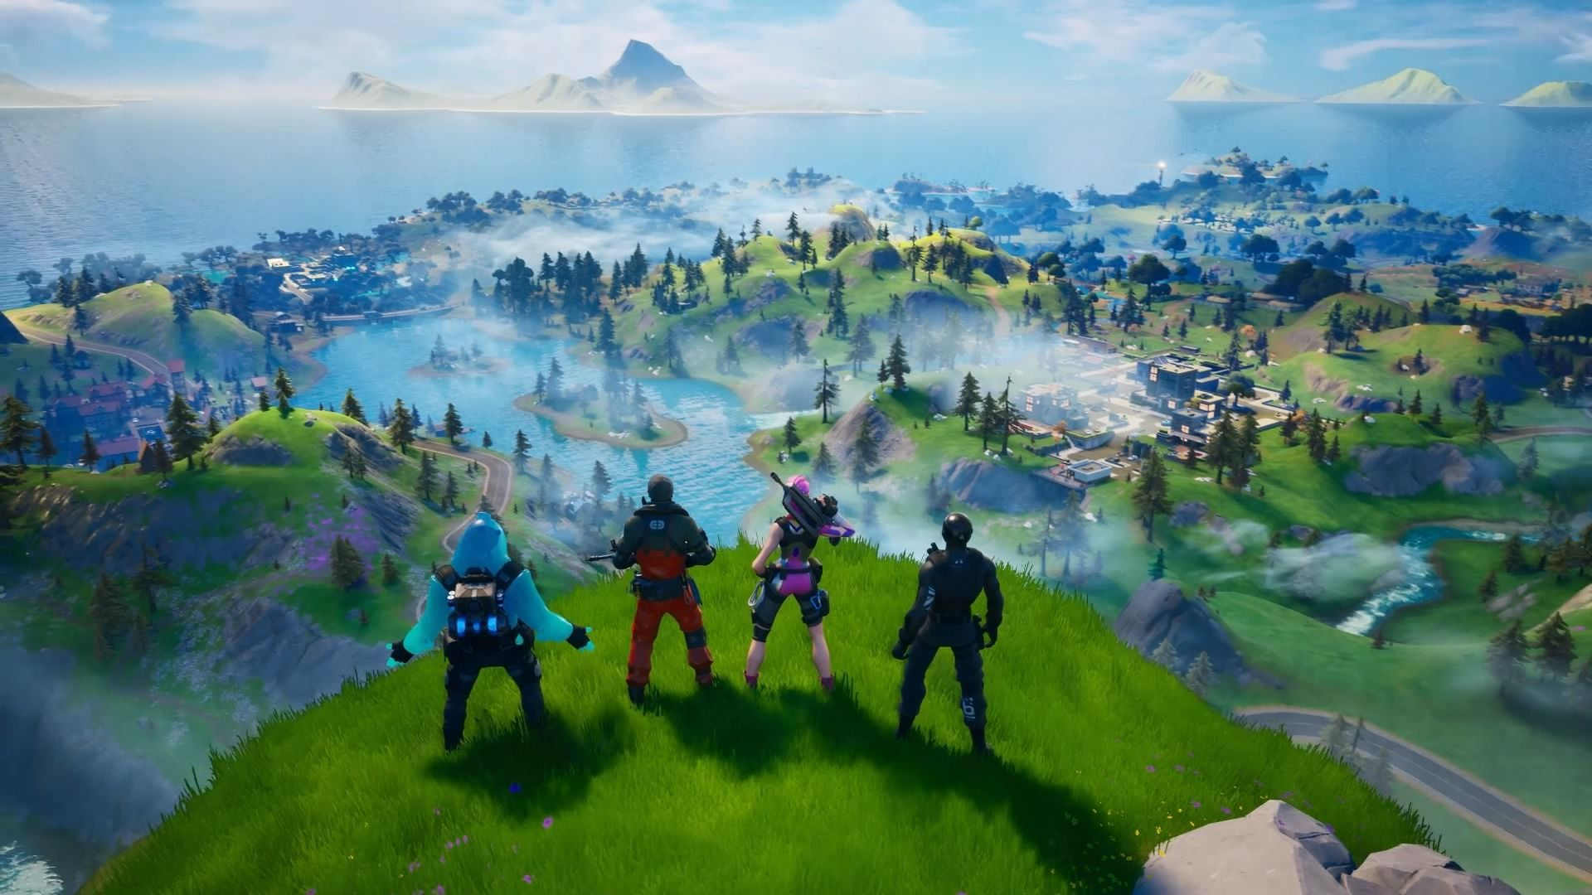
Fortnite
Felipe López
Sebastian Woolfolk

Slide 2


Description
Fortnite Battle Royale es un videojuego gratuito perteneciente al género de Battle Royale desarrollado y publicado por Epic Games
Fortnite Battle Royale is a free to play video game
Battle Royale type of game
Develop by the Epic Games
Multiplatform Game

Slide 3






Platforms
PC
Xbox
Playstation
Nintendo Switch
iOS
Android

Slide 4
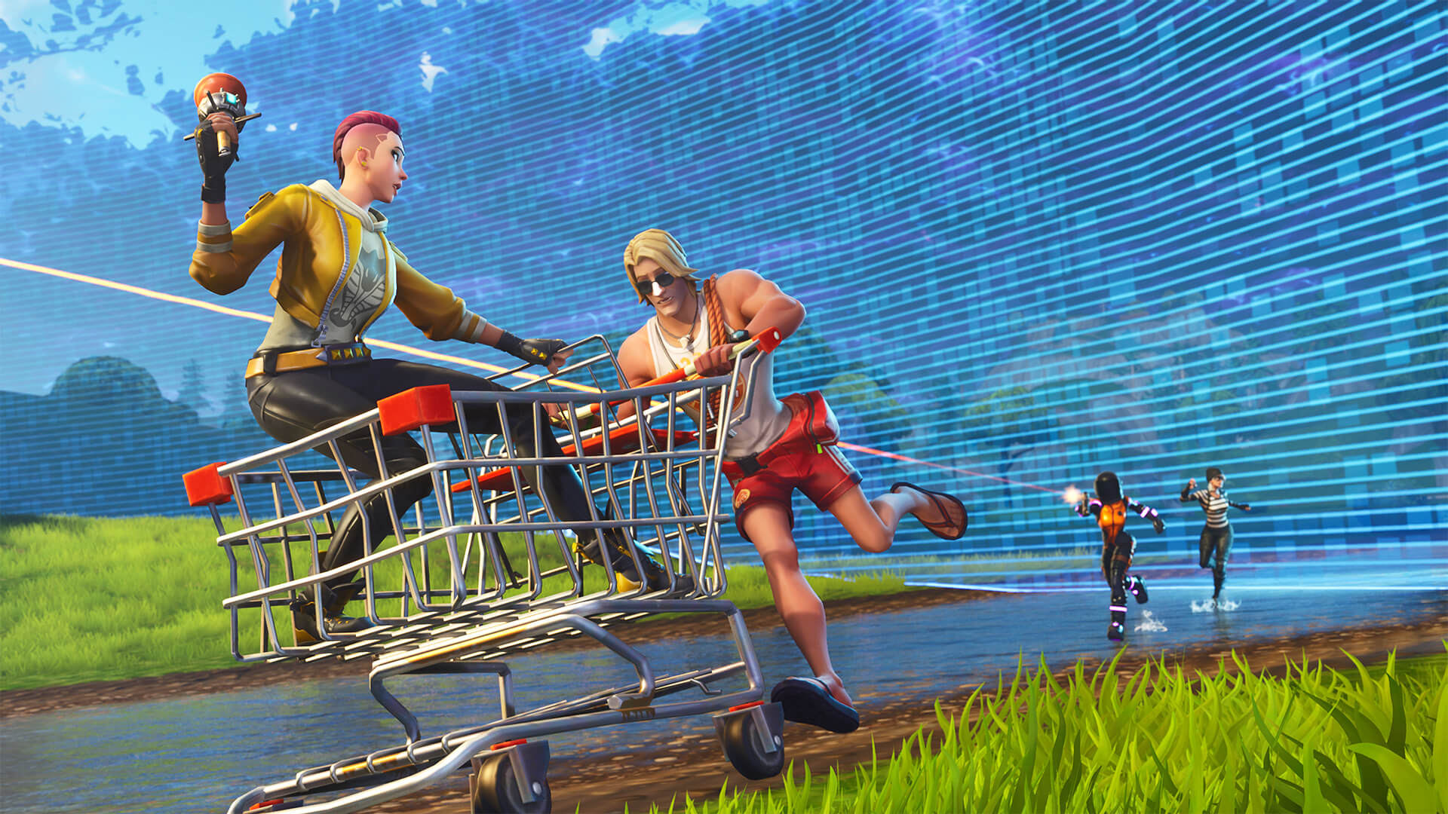
Game Modes
Right know it has 3 types of game modes:
Battle Royale
Solo
Duos
Squads
Rumble (50 vs 50)
Limited Time

Slide 5
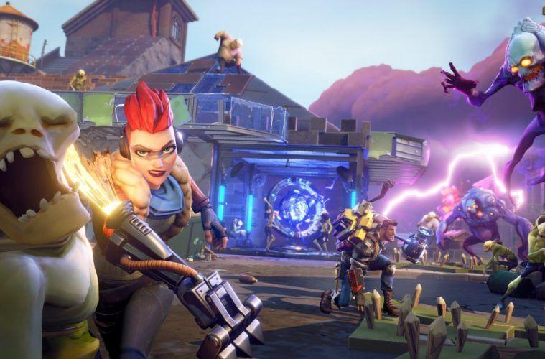
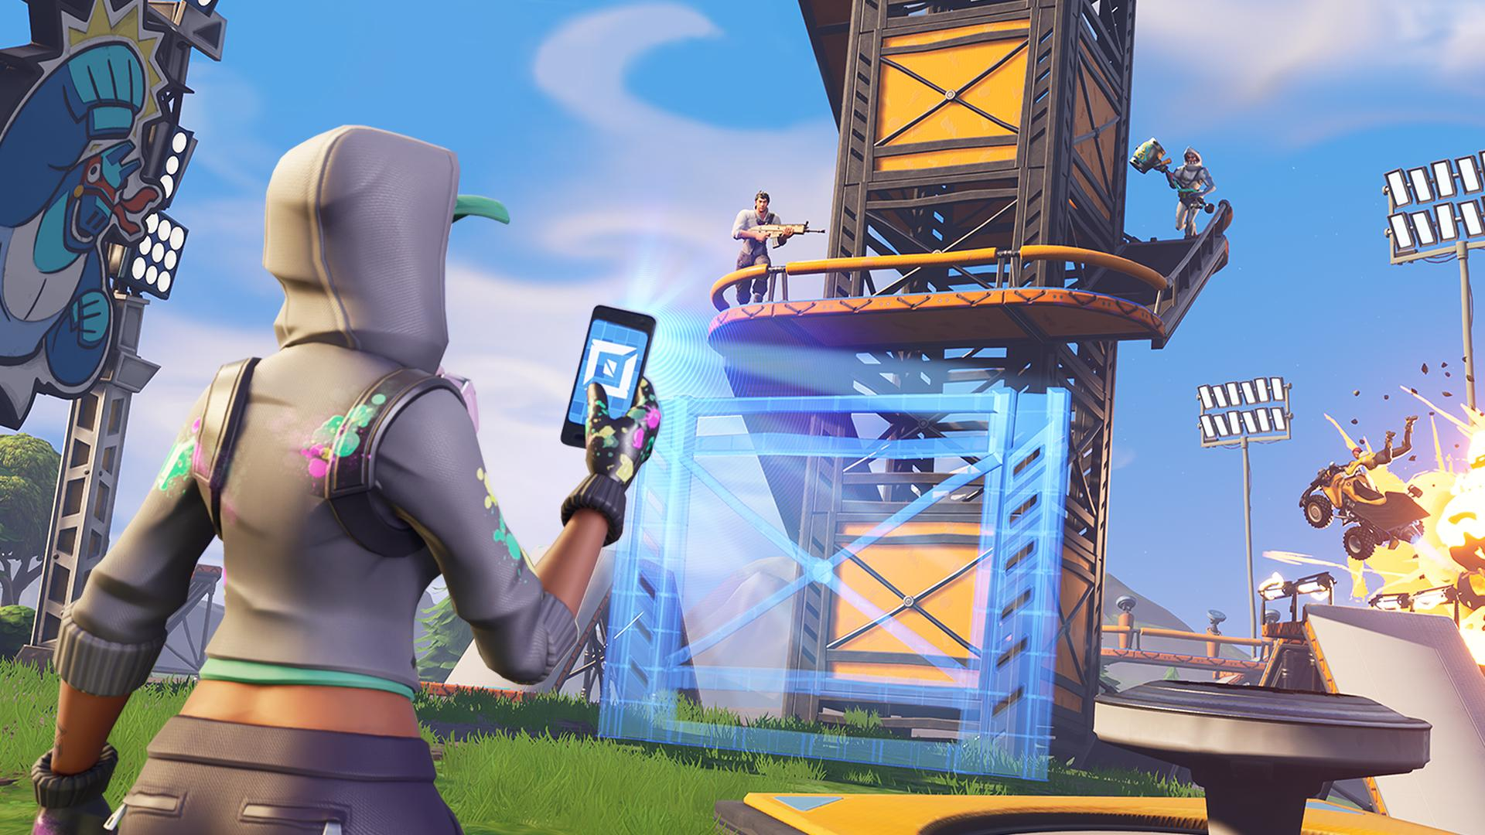
Game Modes
Save the World
Player-versus-environment
Cooperative
Fortnite Creative
Kind of Minecraft

Slide 6
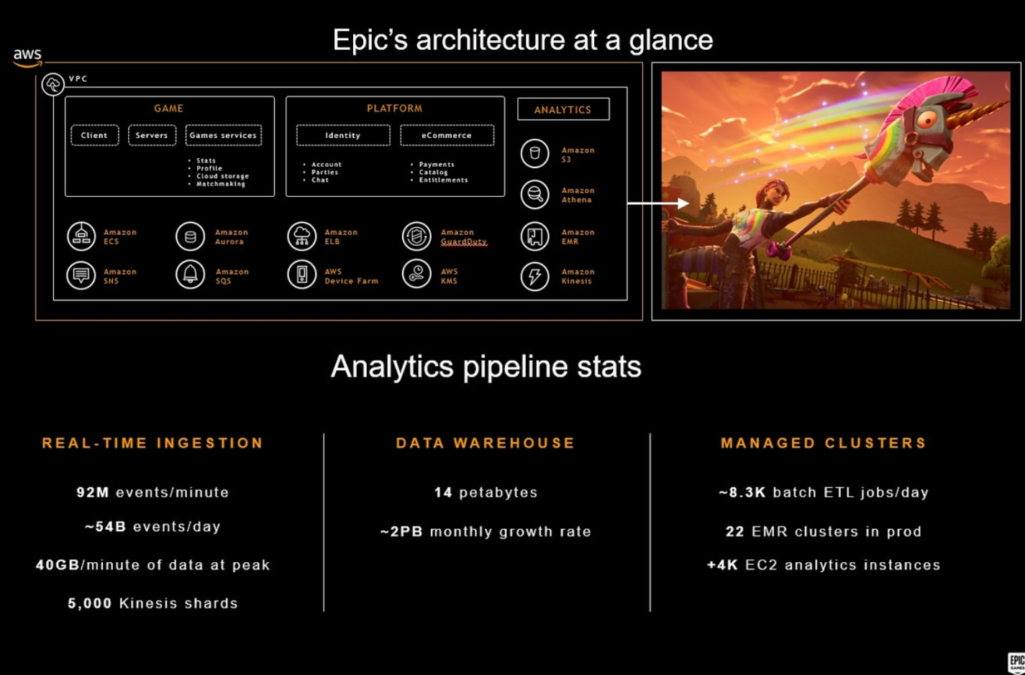
Architecture (software and hardware)

Slide 7
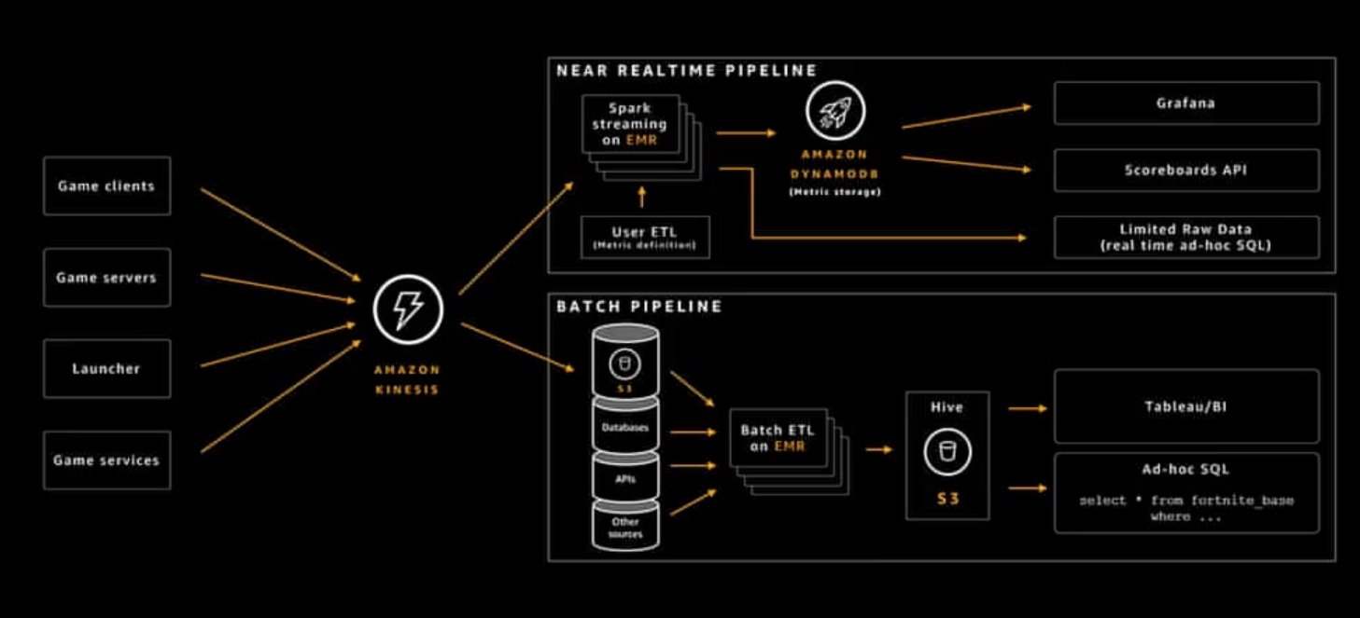

Slide 8
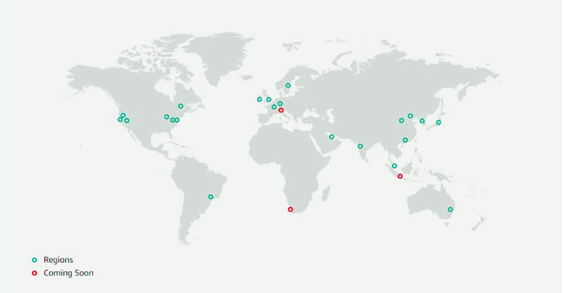

Slide 9
Server Locations
Ohio, USA
Virginia, USA
California, USA
Oregon, USA
Tokyo, Japan
South Korea
Osaka, Japan
Mumbai, India
Singapore
Australia
Canada
Frankfurt, Germany
Ireland
London, UK
Paris, France
Sao Paulo, Brazil

Slide 10
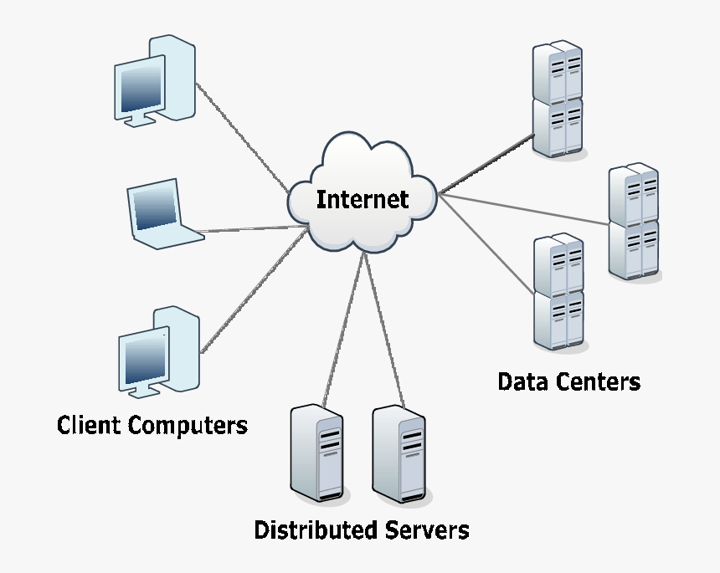
Components
Database
Pipeline
Server
Client

Slide 11
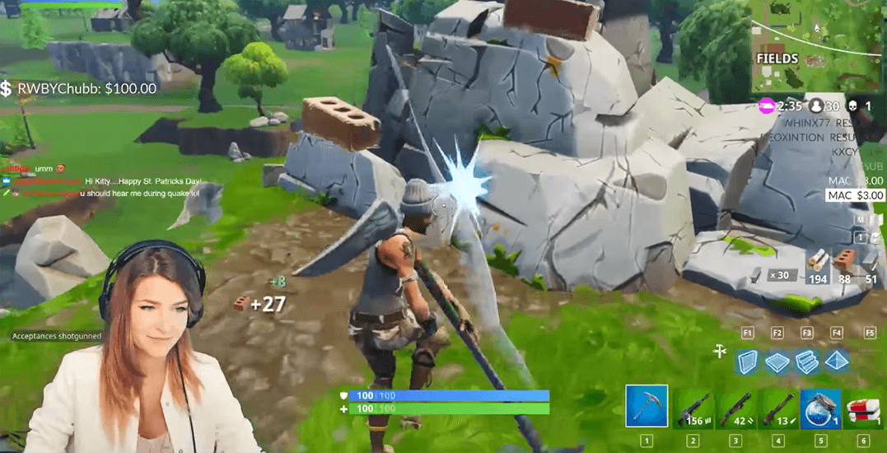
Key learnings, challenges and areas of improvement
The more you play, the more you know

